Slide 1
Survey of Lip-Based Reading Techniques using Image Processing
Dakota Mellish
1

Slide 2
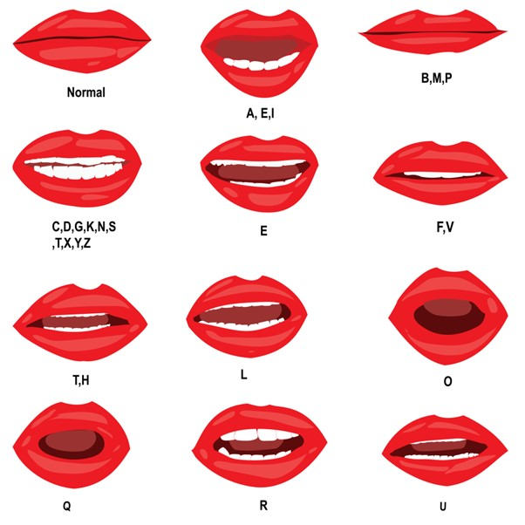
Defining the Task
Artificial Intelligence and Machine learning allows for unique problems to be solved
Of these, an opportunity to tackle a difficult problem presents itself with assisting persons with hearing-related disabilities
Images (different frames of a video) with annotations can be used as a training examples for a model to use for learning. In theory, any video with a transcript can serve as a testing ground.
2
2

Slide 3
The paper considered and Some Vocab
2021 Survey on various techniques (due to the technology’s recent emergence)
5 Researchers from the University of London
Emphasis is centered around deep-learning approaches
Defining some domain-specific concepts
Phoneme: The smallest sound unit for language detectable
Example: The word Cat has three phonemes. Not to be confused with letters
Viseme: The visual patterns and actions associated with each phoneme. This is just the sequence of movements that our mouths make when producing sounds.
Utterance: A spoken word, statement or vocal sound.
Example: A police officer yells “Stop!”. Stop is an utterance
3
2

Slide 4
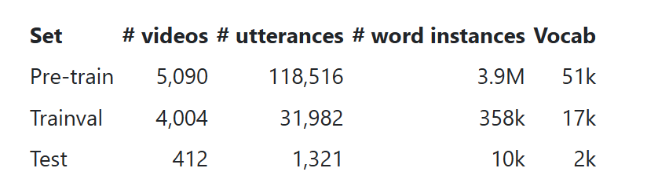
Which Datasets get used for lip-reading?
Authors provide an exhaustive list of over 30 major datasets used for predicting lip reading. Notably, LRS3-TED was discussed. It is parsed from Ted Talks (primarily based in English) and contain videos with annotations of different words and sentences based on the TED talk speakers.
Some Stats on the LRS3-TED Dataset
4
2

Slide 5
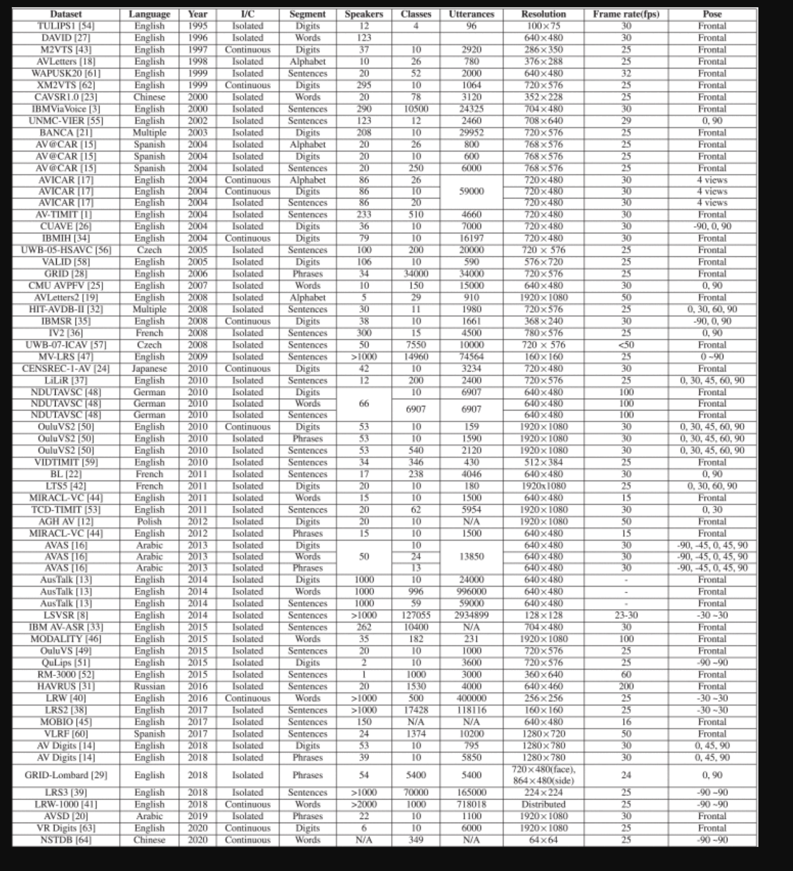
Some other Datasets
5
2

Slide 6
Some Different Deep Learning Techniques
Convolutional Neural Networks (CNNs) are the fundamental building block when it comes to prediction of singular actions, such as predicting a given sound/word given an image.
Recurrent Neural Networks (RNNs) are used more commonly when it comes to trying to predict phenomena such as a sentence sequence.
Gated Recurrent Unit (GRU) – Sequential architecture which uses gates (reset and update) to make predictions. Standard GRU only considers from longest ago to most recent, but bidirectional GRU also goes from most recent to longest ago.
ResNet is a deep neural network in which some backwards updates traverse more than 1 layer and can avoid the vanishing gradient problem. They are used commonly in conjunction with Convolution networks.
Attention Based Transformers and Temporal Convolution Networks (TCNs). They rely on processing information in parallel by considered each token or item in context of all other surrounding tokens. Attention Based Transformers rely on autoencoders and decoders to transform the dataset, and Temporal Convolution Networks are a special case of RNNs
6
2

Slide 7
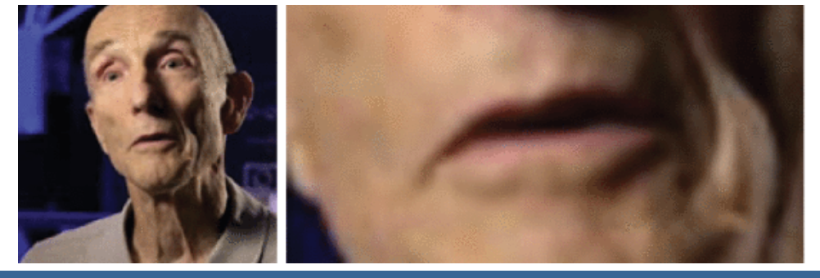
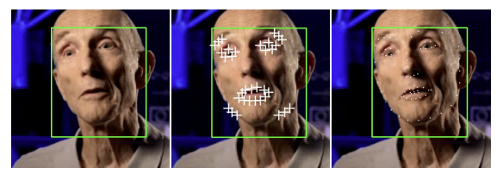
Data (Image) Preprocessing Required
Narrowing in on the region of interest is critical for the models to properly recognize the facial features that make up each word. The ROI can then be enhanced and zoomed in on.
Discretization of the problem is necessary. This can be achieved by sampling various frames of the video. Images are often converted to grayscale as well to improve model performance, though the raw image can be used in a red green blue channel.
Naïve Bayes classifiers, Hidden Markov Models, Neural nets and PCA can be used to localize the facial region. The authors note the common use of iBug, which has a distinct annotated set of landmark features of the human face created by Imperial College London.
7
2

Slide 8
The Convolution Network layer
The authors of the paper draw special attention to the convolution layer. Unlike traditional feed-forward mechanisms in neural networks, this allows for better capture of temporal changes.
2D Convolution Layer – Operates over length and width of the image
Challenge with 2D is that it only captures spatial features, when a lip movement is really a sequence of different frames
3D Convolution Layer – Operates over length, width and frames of a given video
3D is more computationally expensive in its implementation but offers better performance
Some researchers have also used a 3D convolution followed by a set of 2D convolution layers
8
2

Slide 9
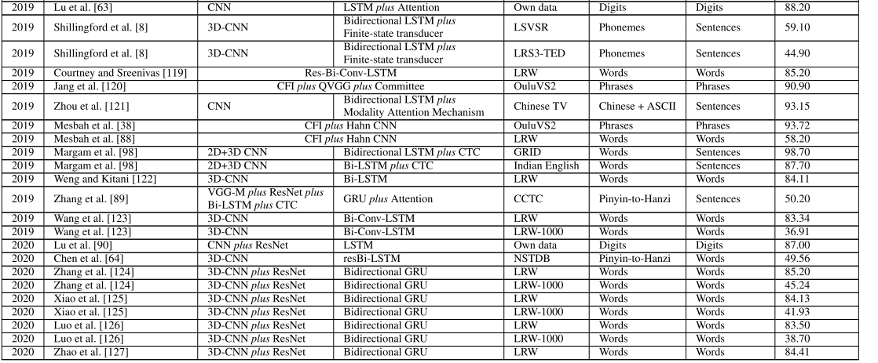
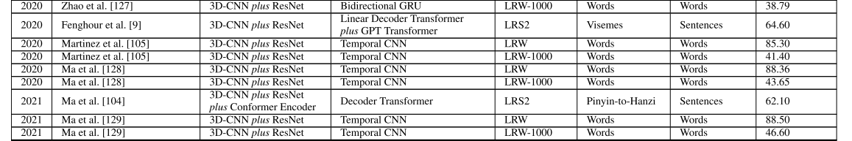
Comparing Different Architectures’ Performance
9
2

Slide 10
How is the output transformed?
A common technique is to rely on ASCII characters and attempt to predict each. This requires thorough annotation for each training example.
An issue with using words as trained is that the model can give an “out of vocabulary”, if not trained on every possible word in a given language.
Visemes and phonemes are also used as a predicted output. Visemes in particular are less computationally expensive and also generalizes better to other languages, as many movements are shared across languages and cultures.
The challenge is that visemes are quite short and there is limited information temporally speaking. Each viseme also needs a 2-stage mapping.
Phonemes to words are also a good option, though there is much overlap between possible words/sounds compared to visemes.
10
2

Slide 11
Possible Enhancements
What about sarcasm and hand gestures?
Do other parts of the body such as the eyes convey more information?
What about slang?
Can a Large Language Model be configured for such a task?
11
2

Slide 12
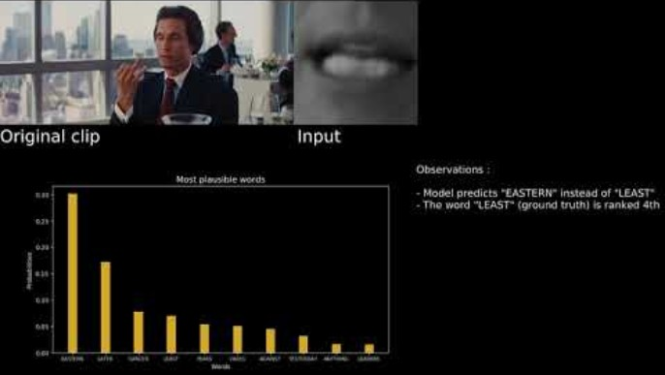
Demo Using CNN – Inception v4
12
2

Slide 13
References
[1] M. K. Singh, A. Kumar, and S. K. Singh, "A Comprehensive Survey on Machine Learning Techniques in Wireless Sensor Networks," IEEE Communications Surveys & Tutorials, vol. 23, no. 2, pp. 1160-1203, Second Quarter 2021, doi: 10.1109/COMST.2021.3058581.
[2] iBUG Group, "Facial Point Annotations," Imperial College London. [Online]. Available: https://ibug.doc.ic.ac.uk/resources/facial-point-annotations/. [Accessed: Mar. 17, 2025].
[3] A. Benkassu, “Lip Reading AI – Demo Video " YouTube, Mar. 17, 2025. [Online]. Available: https://www.youtube.com/watch?v=ZWOyrZUun2s.
13
2

